Slide 1
SOCIAL MEDIA
ANALYTICS
SOCIAL MEDIA
ANALYTICS
Measuring User’s Influence in Twitter
By:
V Sai Pratyusha Akula Bhavani V Jagath Chandra M Madhan

Slide 2
TOP SOCIAL NETWORKING SITES
45%
55%
65%
85%

Slide 3

PLATFORM USED
Twitter is an American microblogging and social networking service on which users post and interact with messages known as "tweets".

Slide 4
THIS IS OUR PROJECT
STEP 1
STEP 2
STEP 3
STEP 4
STEP 5
In this work, we highlight the importance of planning a new digital campaign in a particular region through obtaining the twitter screen names from a particular website, we understood who the social media influencers are in particular region and in which area fall into (e.g., politics, fashion, art, etc.).
API keys
Connect API using OAuthHandler
Obtain required data from a web site
Perform Sentiment anlysis
Represent the processed data in graph

Slide 5
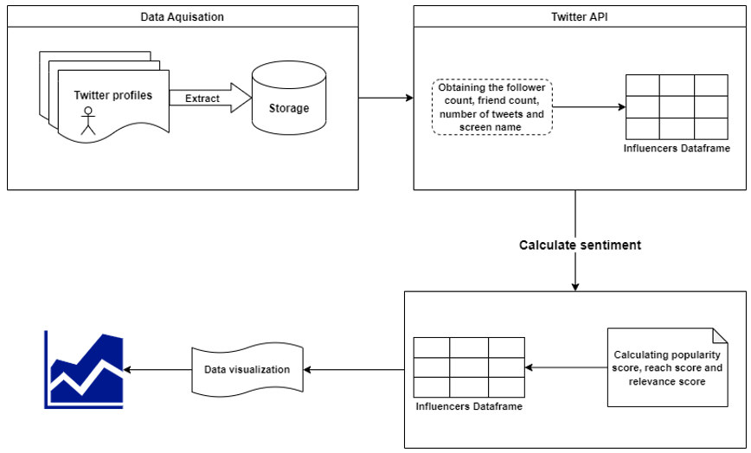
SYSTEM DESIGN

Slide 6
FUTURE ENHANCEMENTS
YOUTUBE
FACEBOOK
INSTAGRAM
REDDIT

Slide 7
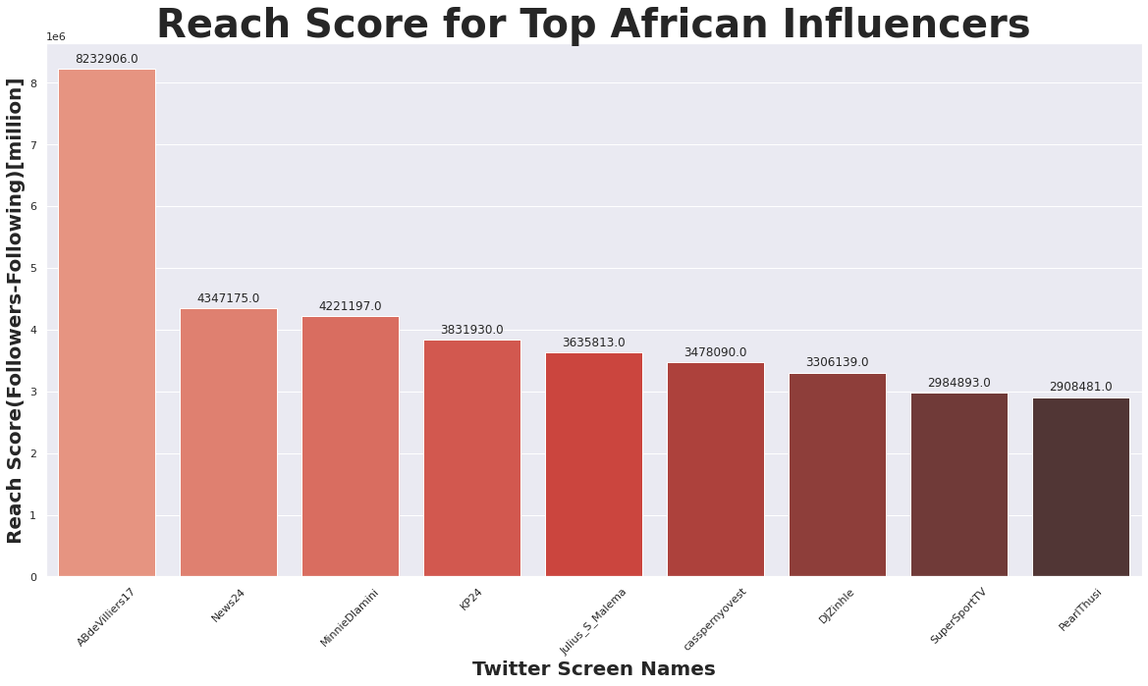
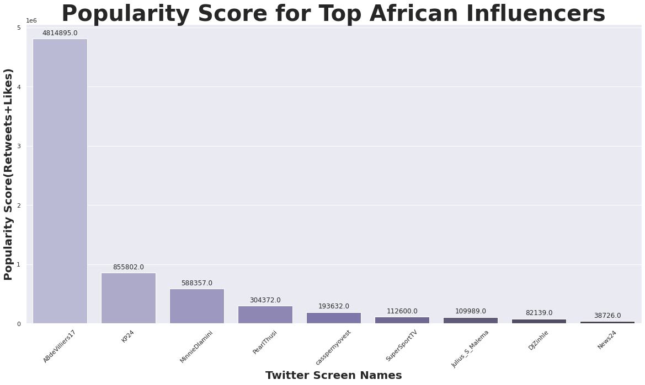
OUTPUT OF THIS PROJECT

Slide 8


